Slide 1
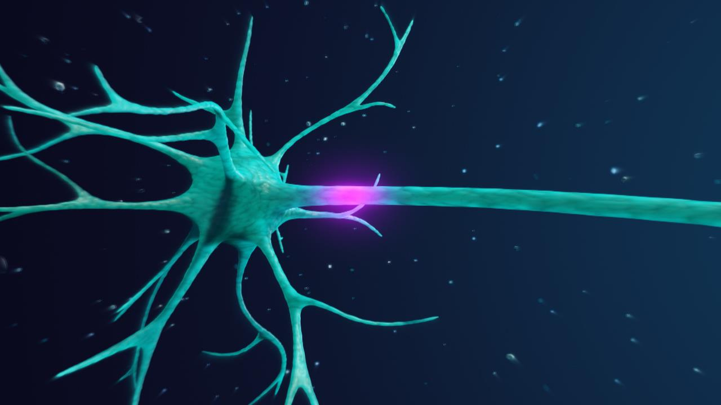
By Austin Pier
Alexander Disease and GFAP

Slide 2
What is Alexander Disease and what are the symptoms?
Neurodegenerative disorder characterized by Rosenthal Fibers.
4 types of AD are recognized, and symptoms include destruction of myelin sheath, seizures, and developmental defects.
Neonatal
Infantile
Increasing Severity of Symptoms
Juvenile
Increasing Life Expectancy
Adult

Slide 3
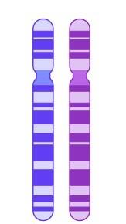
What mutation in GFAP causes Alexander Disease?

Slide 4
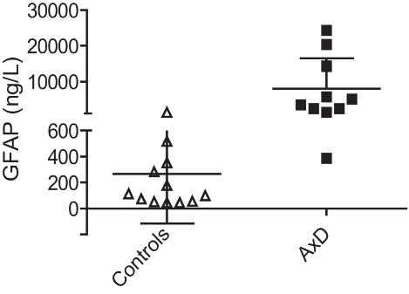
What mutation in GFAP causes Alexander Disease?
Results in G.O.F.
Dominant Mutation
Overexpression of GFAP

Slide 5
GFAP is located at q21.31 on chromosome 17
Where is GFAP located in humans?

Slide 6
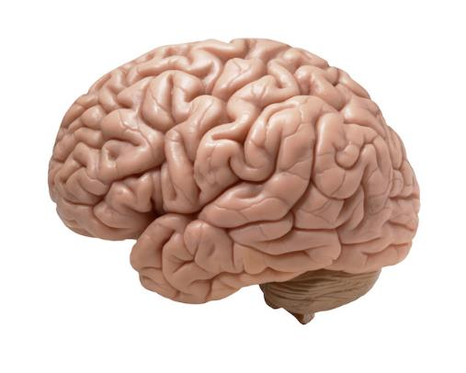
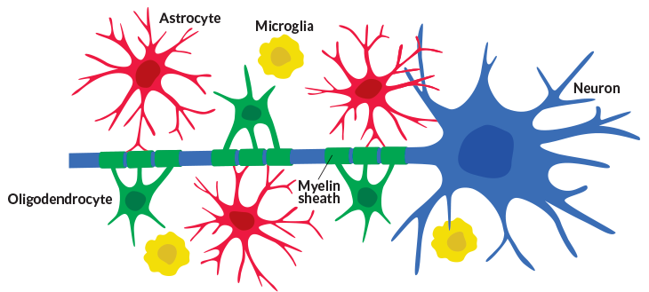
Where is GFAP expressed?
GFAP is expressed primarily in the brain in cells called astrocytes

Slide 7
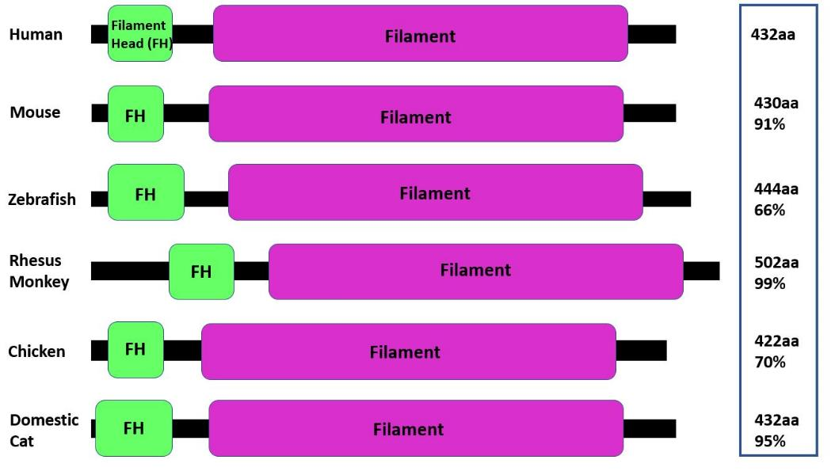
Is GFAP conserved among different species?

Slide 8
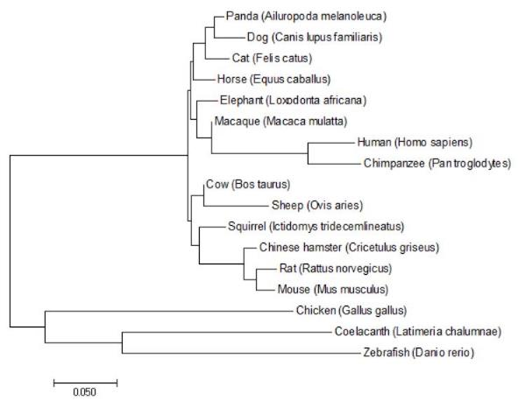
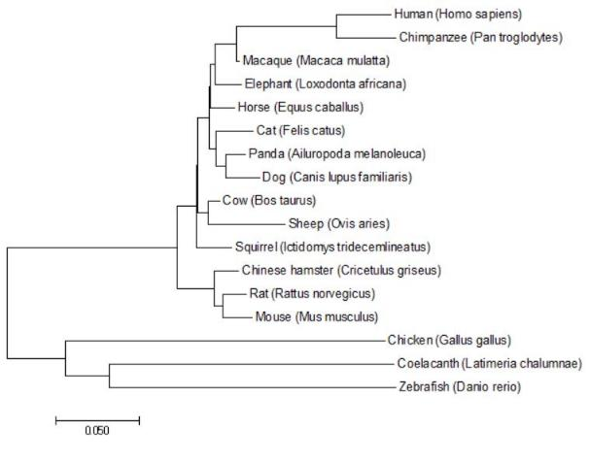
Phylogeny of GFAP
Figure 1: Maximum Likelihood Tree
Figure 2: Minimum Evolution Tree

Slide 9
What is the Gene Ontology of GFAP?
Molecular Function
Biological Process
Cellular Component
Identical Protein Bindng
Integrin binding
Kinase Binding
Cytoskeleton structural constituent
Astrocyte Developent
Long-term synaptic potentiation
Neuron projection regeneration
Regulation of protein complex assembly
Intermediate filament
Astrocyte end-foot
Cell body
Myelin Sheath

Slide 10
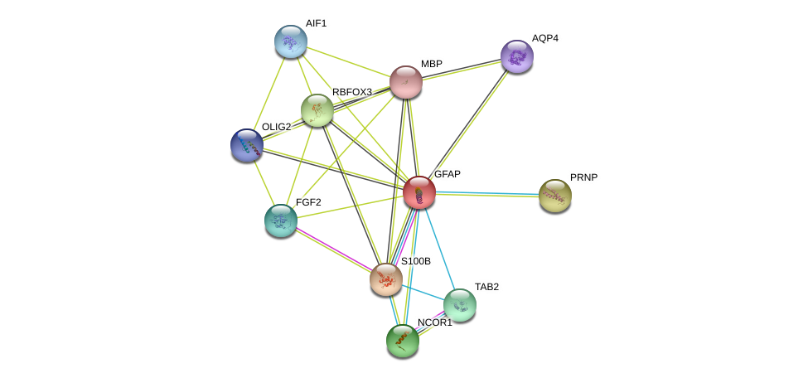
Which Proteins does GFAP interact with?

Slide 11
Which interaction was the focus of my specific aims?
Notes:
Prion proteins are suspected to play a role in myelination and have been found to interact with GFAP, indicating plays a crucial role in myelination, due to the damaged myelin that is observed in Alexander Disease.

Slide 12
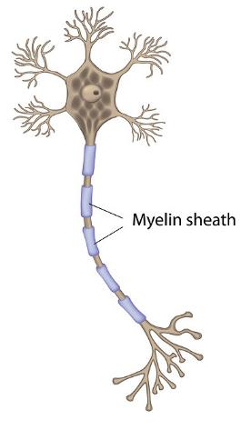
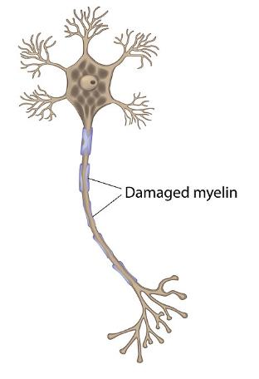
Gap in Knowledge
How does mutant GFAP result in demylenination ?

Slide 13
What is the primary goal? To determine the role of GFAP in myelin sheath maintenance and myelination.
Aim 1
Identify conserved amino acid binding sites for prion proteins.

Slide 14
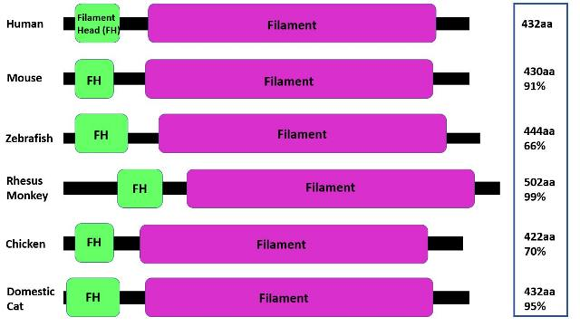
Aim 1: Identify conserved amino acid sites for prion proteins
Domain Analysis
Screen AD mutations
Crispr/Cas9
Co-IP

Slide 15
Aim 1: Identify conserved amino acid sites for prion proteins
Domain Analysis
Screen AD mutations
Crispr/Cas9
Co-IP

Slide 16
Aim 1: Identify conserved amino acid sites for prion proteins
Domain Analysis
Screen AD mutations
Crispr/Cas9
Co-IP

Slide 17
Aim 1: Identify conserved amino acid sites for prion proteins
Domain Analysis
Screen AD mutations
Crispr/Cas9
Co-IP

Slide 18
Work Cited:
https://www.google.com/search?safe=off&tbm=isch&q=neuron+background&chips=q:neuron+background,g_3:desktop&sa=X&ved=0ahUKEwix_amhoqLaAhUJ7Z8KHYUWAqwQ4lYILCgA&biw=1229&bih=587&dpr=1.56#imgrc=96n9iQnbWt5YJM
https://ghr.nlm.nih.gov/gene/GFAP#location
https://www.google.com/search?q=astrocytes+images&safe=off&tbm=isch&tbs=rimg:Cdz171PkBWNwIji49o7uRa1kcGFp7vp-7V_1Dbob9jYHiK4lpy12AxS5wl3B4TrFOKbxP1xwdC_1npxjSyGZYIl-LpsCoSCbj2ju5FrWRwEV3_1aqqC3Y_1cKhIJYWnu-n7tX8MRhozY9ojgvssqEgluhv2NgeIriRGZYismMbHmjioSCWnLXYDFLnCXEcxHQgkJCBz_1KhIJcHhOsU4pvE8Rsw0NE3euhW4qEgnXHB0L-enGNBHrkvPaPeWK4CoSCbIZlgiX4umwEYQgwO-_1HRaY&tbo=u&sa=X&ved=2ahUKEwjt5LGO4KPaAhXrv1QKHX4sCMwQ9C96BAgAEBs&biw=616&bih=572&dpr=1.56#imgrc=1joPtnIOIe-LbM
https://www.google.com/search?q=myelin+sheath+degeneration&safe=off&source=lnms&tbm=isch&sa=X&ved=0ahUKEwitqaPNpqTaAhUNCXwKHfeUBC0Q_AUICigB&biw=614&bih=572#imgrc=qkEsrFYDauG7DM:

Slide 19
Human
Filament Head (FH)
Filament
432aa
Mouse
430aa
91%
FH
Filament
FH
Filament
444aa
66%
Zebrafish
Rhesus Monkey
Filament
502aa
99%
FH
FH
422aa
70%
Chicken
Filament
Domestic Cat
FH
Filament
432aa
95%

