Slide 1
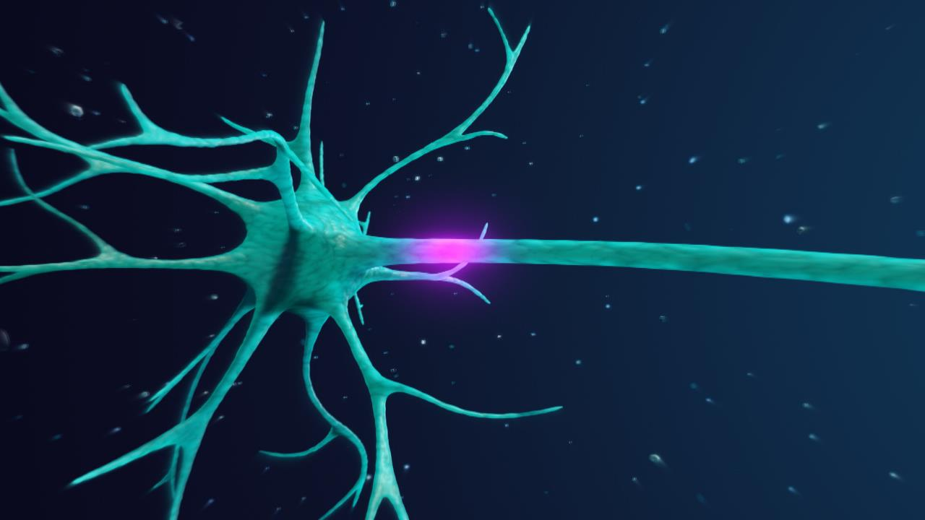
By: Austin Pier
Alexander Disease and GFAP

Slide 2
What is Alexander Disease and what are the symptoms?
Neurodegenerative disorder characterized by Rosenthal Fibers
4 types of AD
Symptoms include destruction of myelin sheath, neuronal dysfunction, seizures, and developmental defects
Neonatal
Infantile
Increasing Severity of Symptoms
Juvenile
Increasing Life Expectancy
Adult

Slide 3
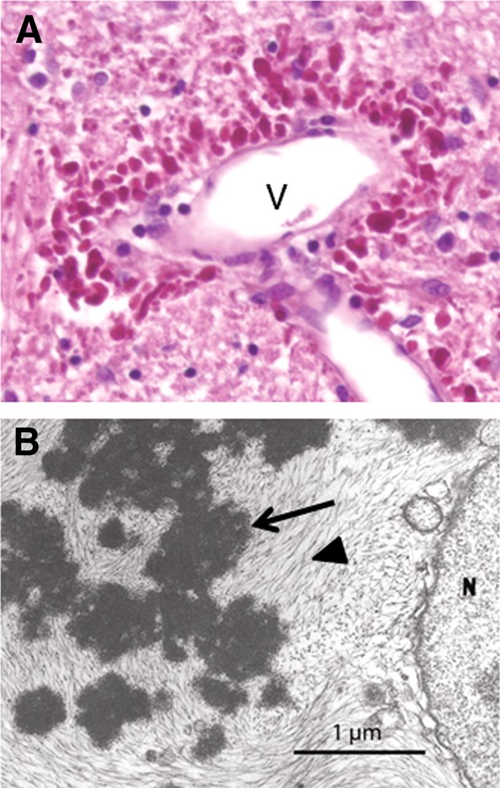
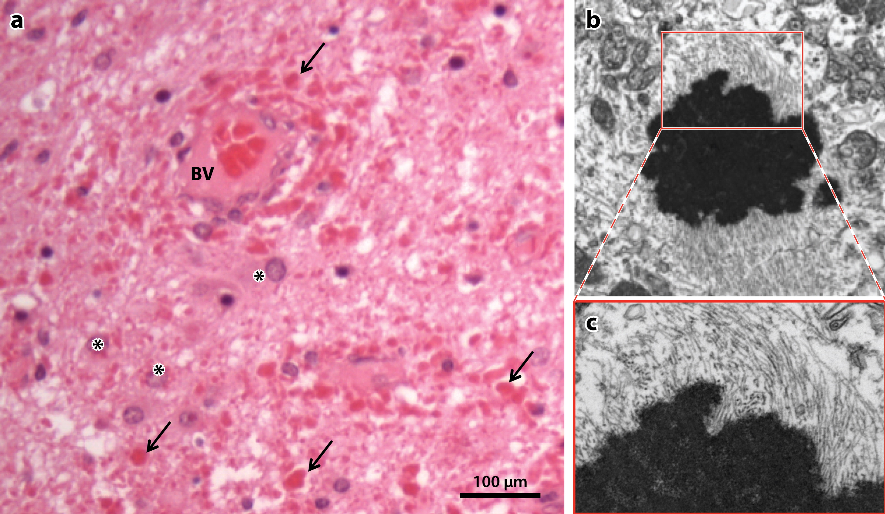
What are Rosenthal Fibers?

Slide 4
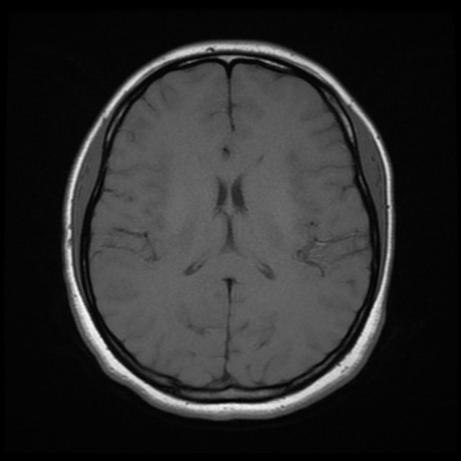
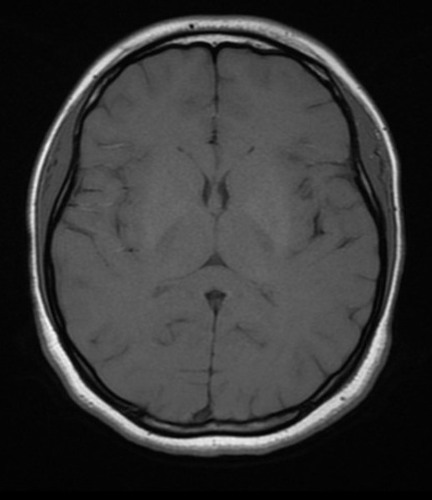
MRI Comparison of Normal vs Alexander Disease Brain
Sever white matter abnormalities
Normal Brain
AD Brain

Slide 5
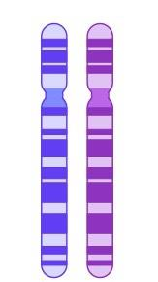
What kind of mutation in GFAP causes Alexander Disease?

Slide 6
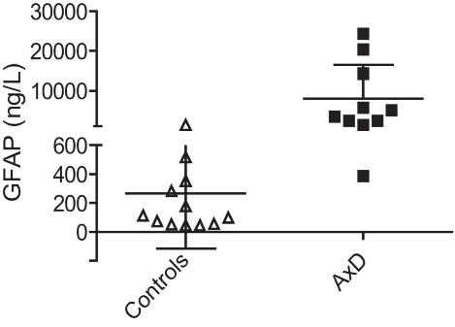
What kind of mutation in GFAP causes Alexander Disease?
Results in G.O.F.
Dominant Mutation
Overexpression of GFAP

Slide 7
GFAP is located at q21.31 on chromosome 17
Where is GFAP located in humans?

Slide 8
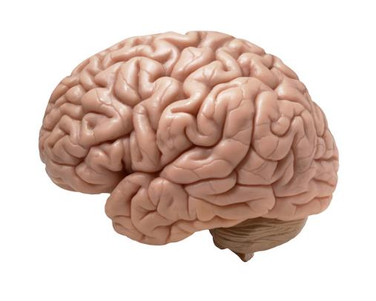
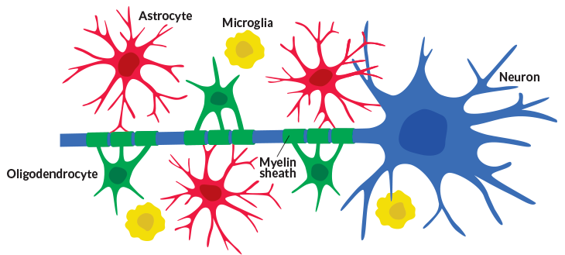
Where is GFAP expressed?
GFAP is expressed primarily in the brain in cells called astrocytes

Slide 9
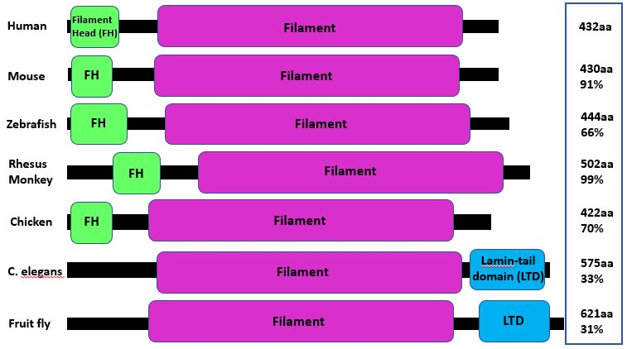
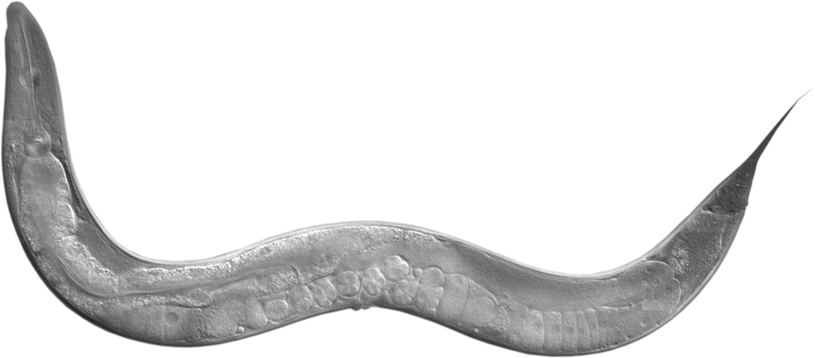
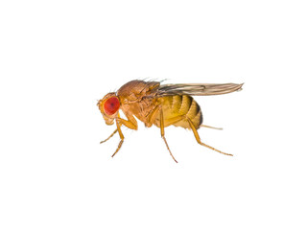
Is GFAP conserved among different species?

Slide 10
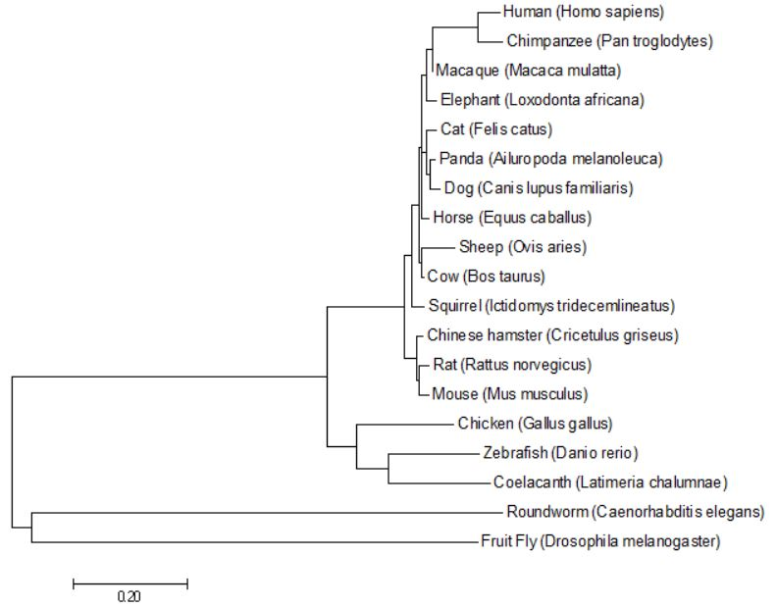
GFAP is most closely conserved among vertebrates

Slide 11
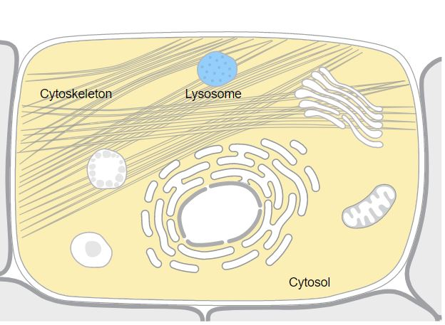
What is the Gene Ontology of GFAP?
Molecular Function
Biological Process
Cellular Component
Protein Binding
Cytoskeleton structural constituent
Regulation of neurotransmitter uptake
Astrocyte development
Regulation of neuron projection development
Intermediate filament
Cytosol
Cytoplasm
GFAP
GFAP
B
A
GFAP

Slide 12
How does Alexander Disease effect human astrocyte morphology?
Normal Human Astrocytes
Human Astrocytes in Alexander Disease

Slide 13
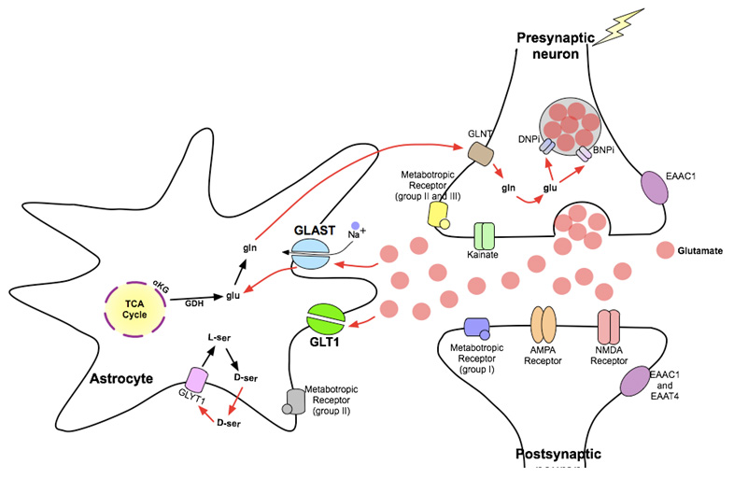
How does Alexander disease effect astrocyte function?
Heightened extracellular glutamate is toxic to neurons!

Slide 14
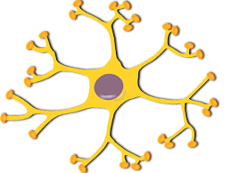
Gap in Knowledge
How does GFAP regulate glutamate uptake and neuronal regulation in astrocytes?

Slide 15
What is the primary goal? To determine the role of GFAP in glutamate uptake and neuronal regulation in astrocytes.
Aim 1
Aim 2
Aim 3
Identify conserved amino acids important for glutamate uptake and neuronal regulation
Identify differentially expressed genes involved in glutamate uptake and neuronal regulation
Identify novel protein interactions necessary for glutamate uptake and neuronal regulation
Notes:
Hypohesis for gap in knowledge

Slide 16
Why use a mouse as my model organism?
Normal
Mutant

Slide 17
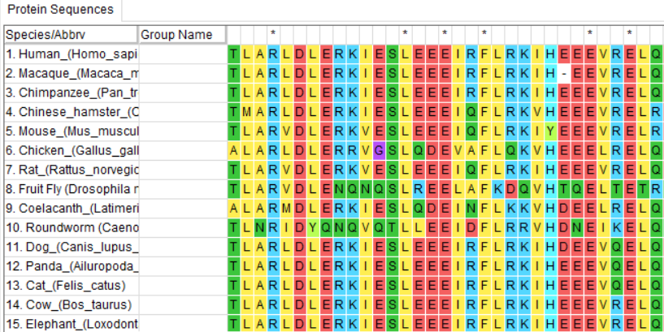
Aim 1: Identify conserved amino acids important for glutamate uptake and neuronal regulation
Multiple Sequence Alignment
Screen AD mutations
CRISPR/Cas9
Identified conserved amino acids

Slide 18
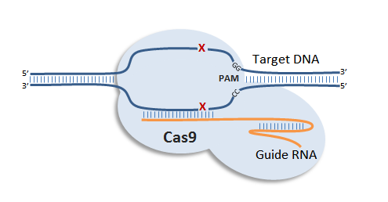
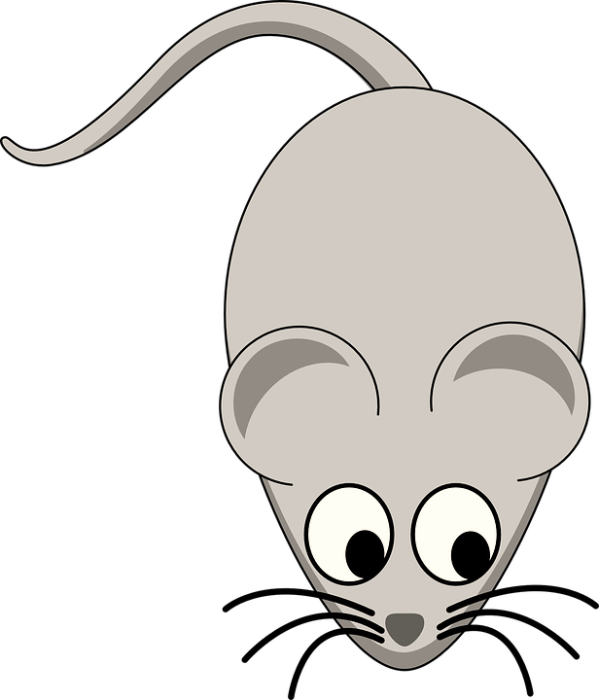
Aim 1: Identify conserved amino acids important for glutamate uptake and neuronal regulation
Multiple Sequence Alignment
Screen AD mutations
CRISPR/Cas9
Mutants:
DNA of conserved amino acids in GFAP

Slide 19
Aim 1: Identify conserved amino acids important for glutamate uptake and neuronal regulation
Multiple Sequence Alignment
Screen AD mutations
CRISPR/Cas9
Hypothesis: Mutations to conserved amino acids will hinder glutamate uptake and neuronal regulation

Slide 20
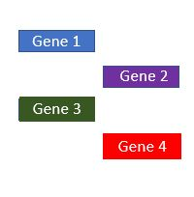
Aim 2: Identify differentially expressed genes involved in glutamate uptake and neuronal regulation
Gene Ontology
Screen AD Mutations
RNA-Seq
CRISPR/Cas9
Differentially expressed genes
Mutant 3
Mutant 2
Mutant 1
Wild type

Slide 21
Aim 2: Identify differentially expressed genes involved in glutamate uptake and neuronal regulation
Gene Ontology
Screen AD mutations
RNA-Seq
CRISPR/Cas9
Genes involved in glutamate uptake and neuronal regulation
Gene 1
Gene 2
Gene 3
Gene 4
Notes:
https://www.logomyway.com/contestView.php?contestId=9400

Slide 22
Aim 2: Identify differentially expressed genes involved in glutamate uptake and neuronal regulation
Gene Ontology
Screen AD mutations
RNA-Seq
CRISPR/Cas9
Mutants:
DNA of differentially expressed genes

Slide 23
Aim 2: Identify differentially expressed genes involved in glutamate uptake and neuronal regulation
Gene Ontology
Screen AD mutations
RNA-Seq
CRISPR/Cas9
Hypothesis: Differentially expressed genes will be involved in glutamate uptake and neuronal regulation
Notes:
https://media-nature-com.ezproxy.library.wisc.edu/original/nature-assets/nm/journal/v11/n1/extref/nm1163-S3.pdf

Slide 24
Aim 3: Identify novel protein interactions necessary for glutamate uptake and neuronal regulation
Gene Ontology
Screen AD Mutations
Tap-MS
CRISPR/Cas9
Tap Tag GFAP in Mice
Affinity purification
Identify
Proteins
Tap Tag
WT and Mutants
Notes:
https://www.biologicscorp.com/blog/methods-for-detection-and-analysis-of-protein-protein-interactions/
http://www.biochemsoctrans.org/content/38/4/883

Slide 25
Aim 3: Identify novel protein interactions necessary for glutamate uptake and neuronal regulation
Tap-MS and Y2H
Gene Ontology
Screen AD Mutations
CRISPR/Cas9
Genes of proteins involved in glutamate uptake and neuronal regulation

Slide 26
Aim 3: Identify novel protein interactions necessary for glutamate uptake and neuronal regulation
Tap-MS and Y2H
Gene Ontology
Screen AD Mutations
CRISPR/Cas9
Mutants:
DNA of novel protein interactors

Slide 27
Aim 3: Identify novel protein interactions necessary for glutamate uptake and neuronal regulation
Tap-MS and Y2H
Gene Ontology
Screen AD Mutations
CRISPR/Cas9
Hypothesis: Interacting proteins will be involved in glutamate uptake and neuronal regulation

Slide 28
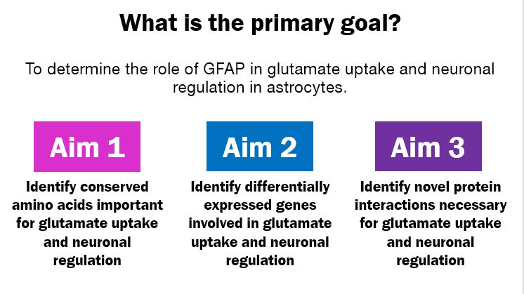
Conclusions
Alexander disease is a fatal neurodegenerative disease caused by mutations to GFAP
Alexander disease causes detrimental effects to neurotransmitter uptake in astrocytes
I intend to elucidate how GFAP regulates glutamate uptake and neuronal regulation

Slide 29
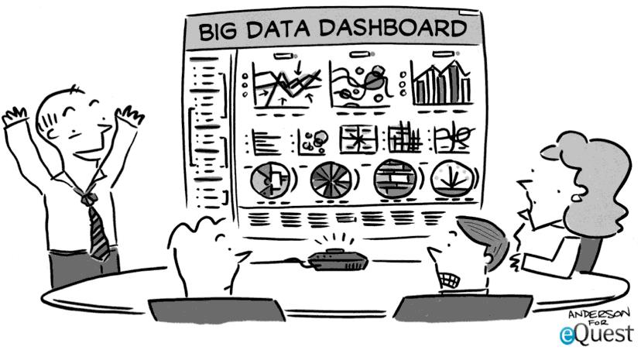
Future Directions

Slide 30
Questions?

Slide 31
Work Cited:
[3] Martidis, A., Yee, R. D., Azzarelli, B., & Biller, J. (1999). Neuro-ophthalmic, radiographic, and pathologic manifestations of adult-onset Alexander disease. Archives of Ophthalmology (Chicago, Ill.: 1960), 117(2), 265–267. [4] Namekawa, M., Takiyama, Y., Aoki, Y., Takayashiki, N., Sakoe, K., Shimazaki, H., … Nakano, I. (2002). Identification of GFAP gene mutation in hereditary adult-onset Alexander’s disease. Annals of Neurology, 52(6), 779–785. https://doi.org/10.1002/ana.10375 [5] Sosunov, A. A., McKhann, G. M., & Goldman, J. E. (2017). The origin of Rosenthal fibers and their contributions to astrocyte pathology in Alexander disease. Acta Neuropathologica Communications, 5, 27. https://doi.org/10.1186/s40478-017-0425-9
Spanagel, R., Pendyala, G., Abarca, C., Zghoul, T., Sanchis-Segura, C., Magnone, M. C., … Albrecht, U. (2005). ERRATUM: The clock gene Per2 influences the glutamatergic system and modulates alcohol consumption. Nature Medicine, 11(2), 233. https://doi.org/10.1038/nm0205-233c
[6] Springer, S., Erlewein, R., Naegele, T., Becker, I., Auer, D., Grodd, W., & Krägeloh-Mann, I. (2000). Alexander disease--classification revisited and isolation of a neonatal form. Neuropediatrics, 31(2), 86–92. https://doi.org/10.1055/s-2000-7479 [7] Srivastava, S., & Naidu, S. (1993). Alexander Disease. In M. P. Adam, H. H. Ardinger, R. A. Pagon, S. E. Wallace, L. J. Bean, K. Stephens, & A. Amemiya (Eds.), GeneReviews®. Seattle (WA): University of Washington, Seattle. Retrieved from http://www.ncbi.nlm.nih.gov/books/NBK1172/
Basic Local Alignment Search Tool. (n.d.). Retrieved March 14, 2018, from http://blast.ncbi.nlm.nih.gov/Blast.cgi [2] Pearson, W. R. (2013). An Introduction to Sequence Similarity (“Homology”) Searching. Current Protocols in Bioinformatics / Editoral Board, Andreas D. Baxevanis ... [et Al.], 0 3. https://doi.org/10.1002/0471250953.bi0301s42 [3] Skop, A. (2018). Lab 2: Homology & Phylogeny. Retrieved March 14, 2018, from http://genetics564.weebly.com/homology--phylogeny.html ​​[3] Sievers F, Wilm A, Dineen D, Gibson T, Karplus K, Li W, Lopez R, McWilliam H, Remmert M, Söding J, Thompson J, Higgins D, Fast, scalable generation of high-quality protein multiple sequence alignments using Clustal Omega, MSB 7 (2011) 1-6. PMID: 21988835 [4] Skop, A. (2018). Lab 2: Homology & Phylogeny. Retrieved March 14, 2018, from http://genetics564.weebly.com/homology--phylogeny.html
[2] Skop, A. (2018).Lab 3: Protein domain discovery & DNA motifs. Retrieved April 12, 2016, from http://genetics564.weebly.com/motif--domain-discovery.html
Olabarria, M., & Goldman, J. E. (2017). Disorders of Astrocytes: Alexander Disease as a Model. Annual Review of Pathology: Mechanisms of Disease, 12(1), 131–152. https://doi.org/10.1146/annurev-pathol-052016-100218
https://www.google.com/search?safe=off&tbm=isch&q=neuron+background&chips=q:neuron+background,g_3:desktop&sa=X&ved=0ahUKEwix_amhoqLaAhUJ7Z8KHYUWAqwQ4lYILCgA&biw=1229&bih=587&dpr=1.56#imgrc=96n9iQnbWt5YJM
https://ghr.nlm.nih.gov/gene/GFAP#location
https://www.google.com/search?q=astrocytes+images&safe=off&tbm=isch&tbs=rimg:Cdz171PkBWNwIji49o7uRa1kcGFp7vp-7V_1Dbob9jYHiK4lpy12AxS5wl3B4TrFOKbxP1xwdC_1npxjSyGZYIl-LpsCoSCbj2ju5FrWRwEV3_1aqqC3Y_1cKhIJYWnu-n7tX8MRhozY9ojgvssqEgluhv2NgeIriRGZYismMbHmjioSCWnLXYDFLnCXEcxHQgkJCBz_1KhIJcHhOsU4pvE8Rsw0NE3euhW4qEgnXHB0L-enGNBHrkvPaPeWK4CoSCbIZlgiX4umwEYQgwO-_1HRaY&tbo=u&sa=X&ved=2ahUKEwjt5LGO4KPaAhXrv1QKHX4sCMwQ9C96BAgAEBs&biw=616&bih=572&dpr=1.56#imgrc=1joPtnIOIe-LbM
https://www.google.com/search?q=myelin+sheath+degeneration&safe=off&source=lnms&tbm=isch&sa=X&ved=0ahUKEwitqaPNpqTaAhUNCXwKHfeUBC0Q_AUICigB&biw=614&bih=572#imgrc=qkEsrFYDauG7DM:
https://radiopaedia.org/cases/normal-brain-mri-6
https://www-annualreviews-org.ezproxy.library.wisc.edu/na101/home/literatum/publisher/ar/journals/content/pathmechdis/2017/pathmechdis.2017.12.issue-1/annurev-pathol-052016-100218/20170125/images/large/pm120131.f2.jpeg
https://www.nature.com/articles/s41598-017-03024-0/figures/3
https://www.google.com/search?safe=off&hl=en&tbm=isch&sa=1&ei=pHjnWvqYJuSYjwSd3pVA&q=mouse+clipart+transparent+background&oq=mouse+clipart&gs_l=psy-ab.1.5.0l10.1936.4556.0.5933.16.13.1.2.2.0.357.1561.0j7j1j1.10.0....0...1c.1.64.psy-ab..3.12.1574.0..0i67k1.100.HnxGOTV8pxE#imgrc=CwH62dJUds5UQM:
http://www.uniprot.org/uniprot/P14136#function

